Slide 1

The Secrets of Salient Object Segmentation
Yin Li -1, Xiaodi Hou -2, Christof Koch -3, James M. Rehg -1, Alan L. Yuille -4
1-Gerogia Institute of Technology, 2-California Institute of Technology,
3-Allen Institute for Brain Science, 4-University of California, Los Angeles
Presented by : Sai Anirudh Kondaveeti
Course : INF 6803 -- Traitements vidéo et applications

Slide 2
Outline
Introduction
Terms and Concepts
Problem in present scenario
Overview
Dataset Analysis
Proposing a new dataset(PASCAL-S)
Evaluating dataset consistency
Benchmarking
Dataset design bias
Proposed Algorithm
The model
Limits of the model
Results
Conclusion

Slide 3
Introduction
Visual saliency refers to the ability to select important visual information for further processing.
Fixation prediction
Salient object segmentation
The existing method have two limitations:
Algorithms focusing on one type of saliency tend to overlook the connection to the other side.
Benchmarking primarily on one dataset tend to overt the inherent bias of that dataset.
Discuss the connection between fixation prediction and salient object segmentation. Then discuss dataset design bias , propose a new model of salient object segmentation and then compare it with existing state of art algorithms.
Notes:
In a fixation experiment, saliency is expressed as eye gaze. Subjects are asked to view each image for seconds while their eye fixations are recorded. The goal of an algorithm is to compute a probabilistic map of an image to predict the actual human eye gaze patterns. Patch Based, pixel based feature to extract and then finally a local or global step that renormalize feature saliency values.
In a salient object segmentation dataset, image labellers annotate an image by drawing pixel-accurate silhouettes of objects that are believed to be salient.
Despite the deep connections between the problems of fixation prediction and object segmentation, there is a discomforting isolation between major computational models of the two types. Because of series of differences in ground truth and evaluation procedures. A typical fixation ground truth contains several fixation dots, while a salient object ground-truth usually have one or several positive regions composed of thousands of pixels.
Centre Bias : Subject look more often at the centre of screen. It may be due to chin rest or the photographer bias to centre the objects.

Slide 4
Fixation algorithms
Salient object segmentation Algorithms
Fixation algorithms dataset
Salient object segmentation dataset
ITTI
AIM
GBVS
DVA , etc.
FT
GC
SF
PCAS
Judd
Cerf
IS
Bruce
FT
IS
Bruce

Slide 5
Dataset Analysis
PASCAL-S
PASCAL-S dataset is built on the validation set of the PASCAL VOC 2010 segmentation challenge. This subset contains 850 natural images.
In the fixation experiment, 8 subjects were instructed to perform the “freeviewing“ task to explore the images. Each image was presented for 2 seconds, and eye-tracking re-calibration was performed on every 25 images. The eye gaze data was sampled using Eyelink 1000 eye-tracker, at 125Hz.
In the salient object segmentation experiment, we first manually perform a full segmentation to crop out all objects in the image. Then the 12 subjects label them. The final saliency value of each segment is the total number of click it receives, divided by the number of subjects.

Slide 6
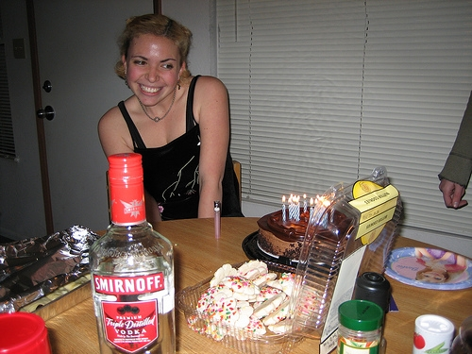

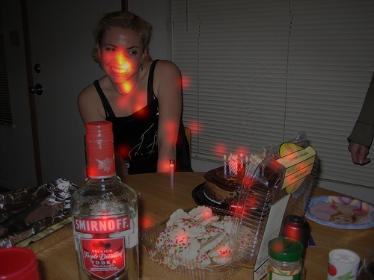

ORIGINAL IMAGE
FULL SEGMENTATION
EYE FIXATIONS
SALIENT OBJECT MASKS

Slide 7
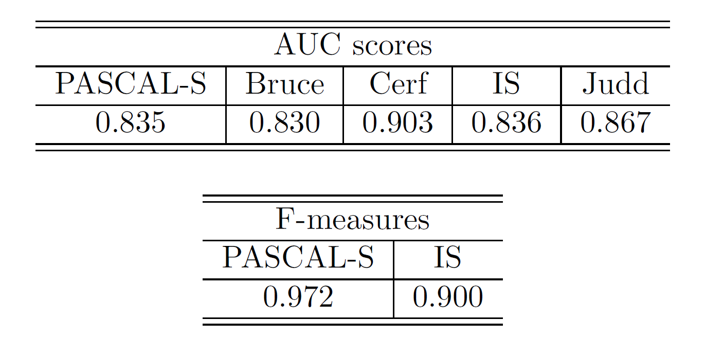
Evaluating dataset consistency
To compare the level of agreement among different labellers in our PASCAL-S dataset and other existing dataset, we randomly select 50% of the subjects as the test subset. Then we benchmark the saliency maps of this test subset by taking the rest subjects as the new ground-truth subset.

Slide 8
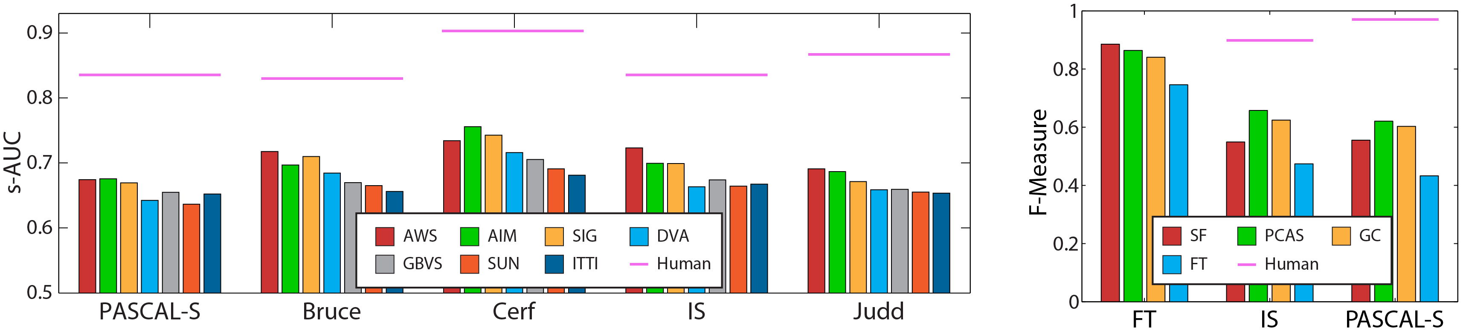
Benchmarking
The purposes of this analysis are:
To highlight the generalization power of algorithms
To investigate inter-dataset difference among these independently constructed datasets
Notes:
The average performance of all 4 algorithms have dropped, from FT's 0:8341, to 0:5765 (30:88% drop) on IS, and 0:5530 (33:70% drop) on PASCAL-S – Segmentation

Slide 9
Dataset design bias
The following image statistics are used to find similarities and differences:
Local color contrast : Boundary detection is an inevitable step in most salient objects detectors. It is important to check whether the boundaries are “unnaturally" easy to segment.
Global color contrast: For each object, we calculate the Χ² distance between its RGB histogram and the background RGB histogram.
Local gPB boundary strength : Combines local and global cues to give a more comprehensive estimate of the presence of a boundary.
Object size : In each image the size of an object is proportion of pixels in the image.
During the design of a dataset, the image annotation process should be independent of the image selection process. Otherwise the dataset design bias will arise as a result of disproportionate sampling of positive/negative examples.

Slide 10
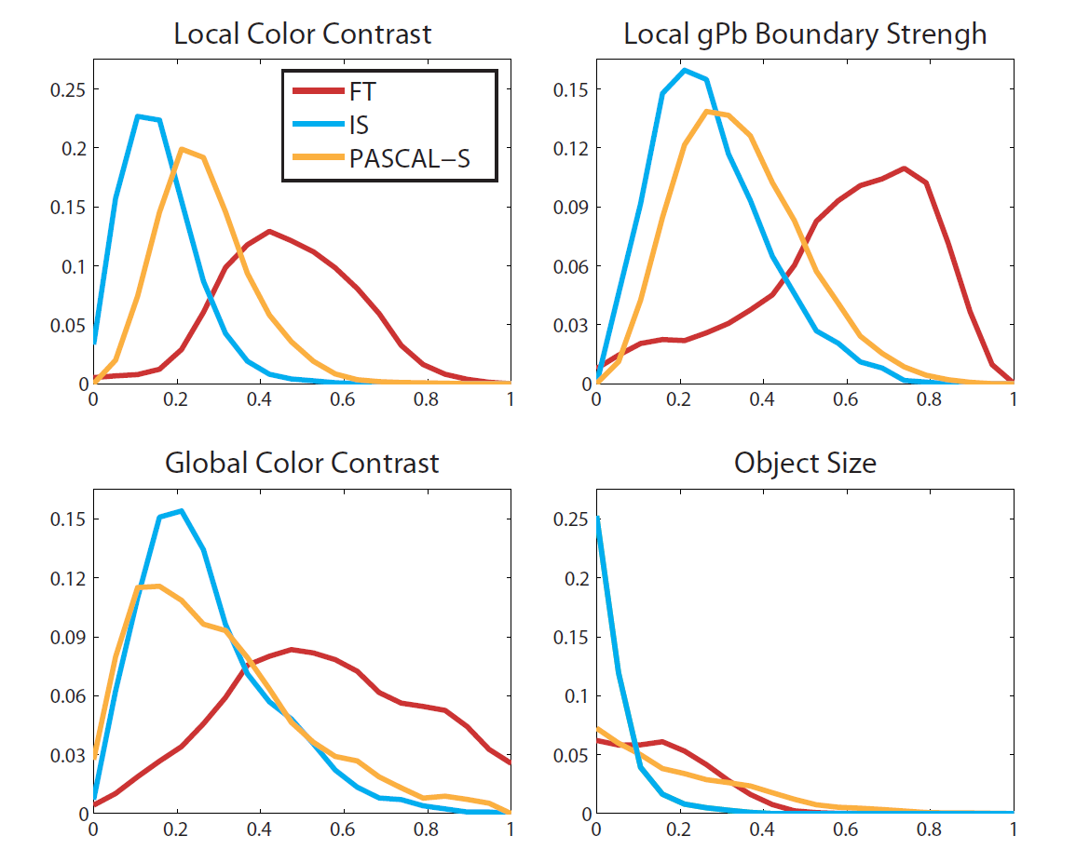

Slide 11
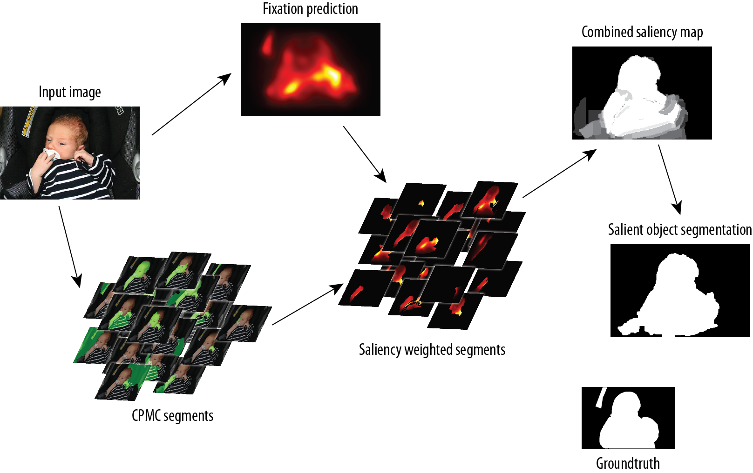
Proposed Algorithm

Slide 12
The Model
Our first step is to generate the segmentation of object candidates by a generic object proposal method. We use CPMC to obtain the initial segmentations.
CPMC is an unsupervised framework to generate and rank plausible hypotheses of object candidates without category specific knowledge.
To estimate the saliency of a candidate segment, we utilize the spatial distribution of fixations within the object. It is well known that the density of fixation directly reveals the saliency of the segment.
We use a learning based framework for the segment selection process. This is achieved by learning a scoring function for each object candidate.
For each dataset, we train a random forest with 30 trees, using a random sampling of 40% of the images. The rest of images are used for testing.
For each branch node, a feature is selected from a random subset of all features and a decision boundary is set by minimizing the Minimum Square Error.

Slide 13
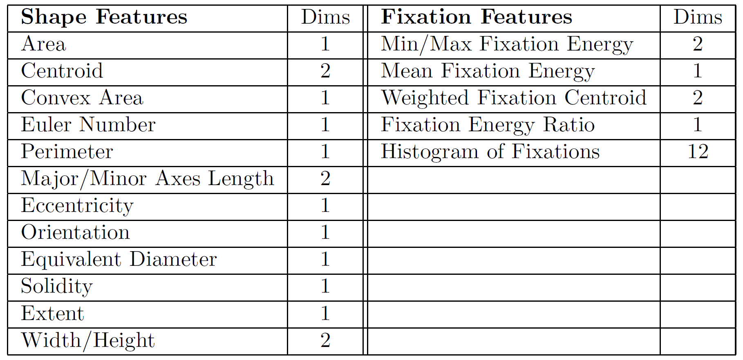
The feature is a 33 dimensional vector which has mainly two types of information. Shape features and fixation distribution features within the object.
We generate the salient object segmentation by averaging the top-K segments at pixel level and then use simple thresholding to generate the final object masks.

Slide 14
Limits of the model
Our model contains two separate parts: a segmenter that proposes regions, and a selector that gives each region a saliency score.
First, we quantify the performance upper-bound of the selector, and then, best achievable results of the segmenter is also presented.
To test upper-bound of the selector, we train our model on the ground-truth segments of PASCAL-S with human fixation maps. It achieves a F-Measure of 0.9201 . This result is a strong validation to bridge the gap between fixations and salient objects.
To test upper bound of CPMC segmentation algorithm. We match the each segment from CPMC to the ground truth object annotations, and greedily choose the segments with best overlapping scores. We get F-measures of 0.8699 , 0.9496 and 0.8416 on PASCAL-S, FT and IS respectively.

Slide 15
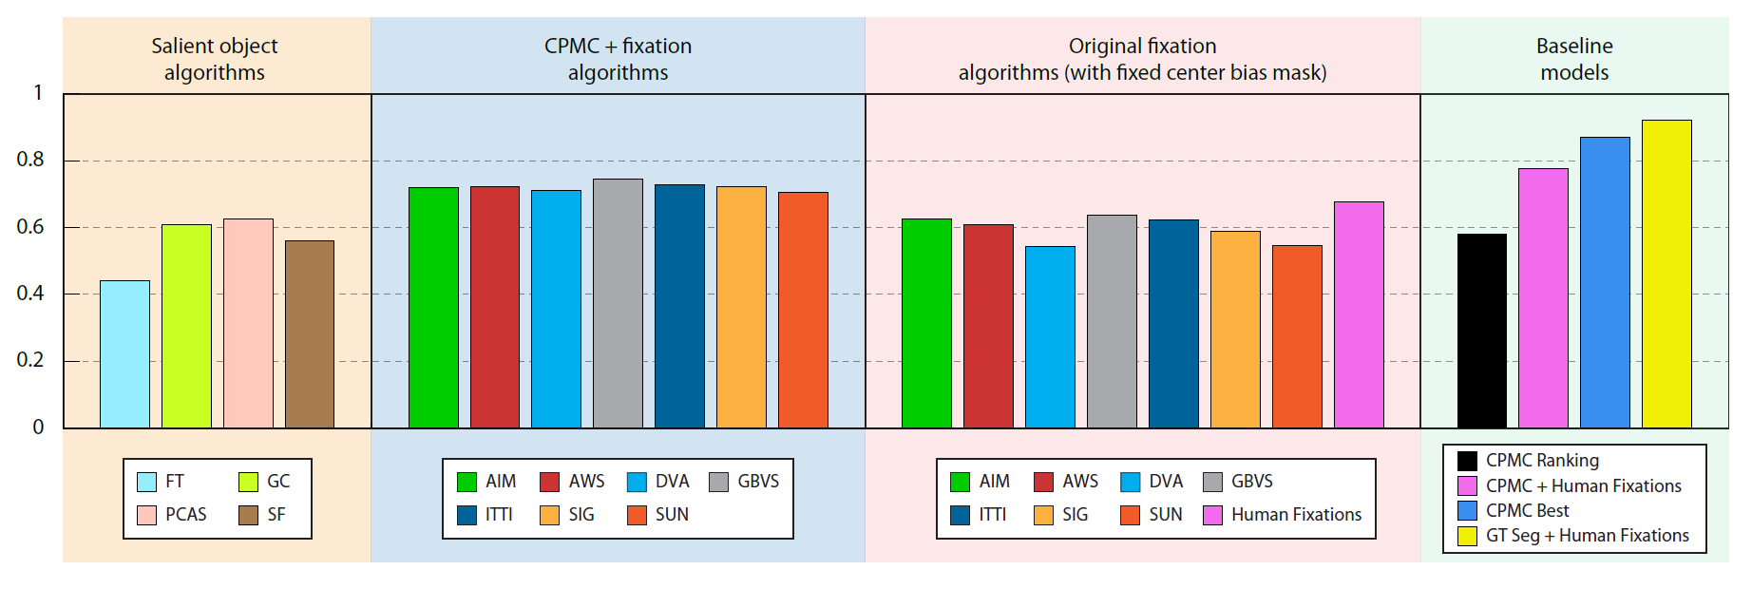
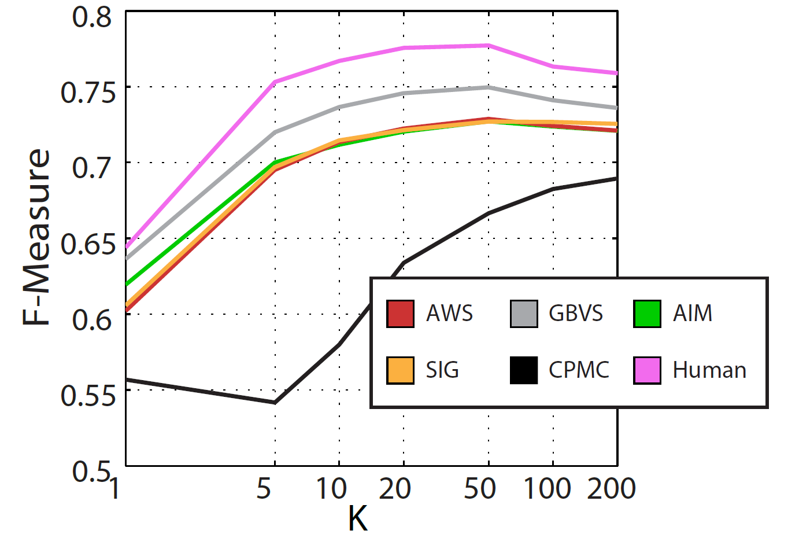
Results
F-measure on PASCAL-S dataset. All CPMC+Fixation results are obtained
using the top K = 20 segments

Slide 16
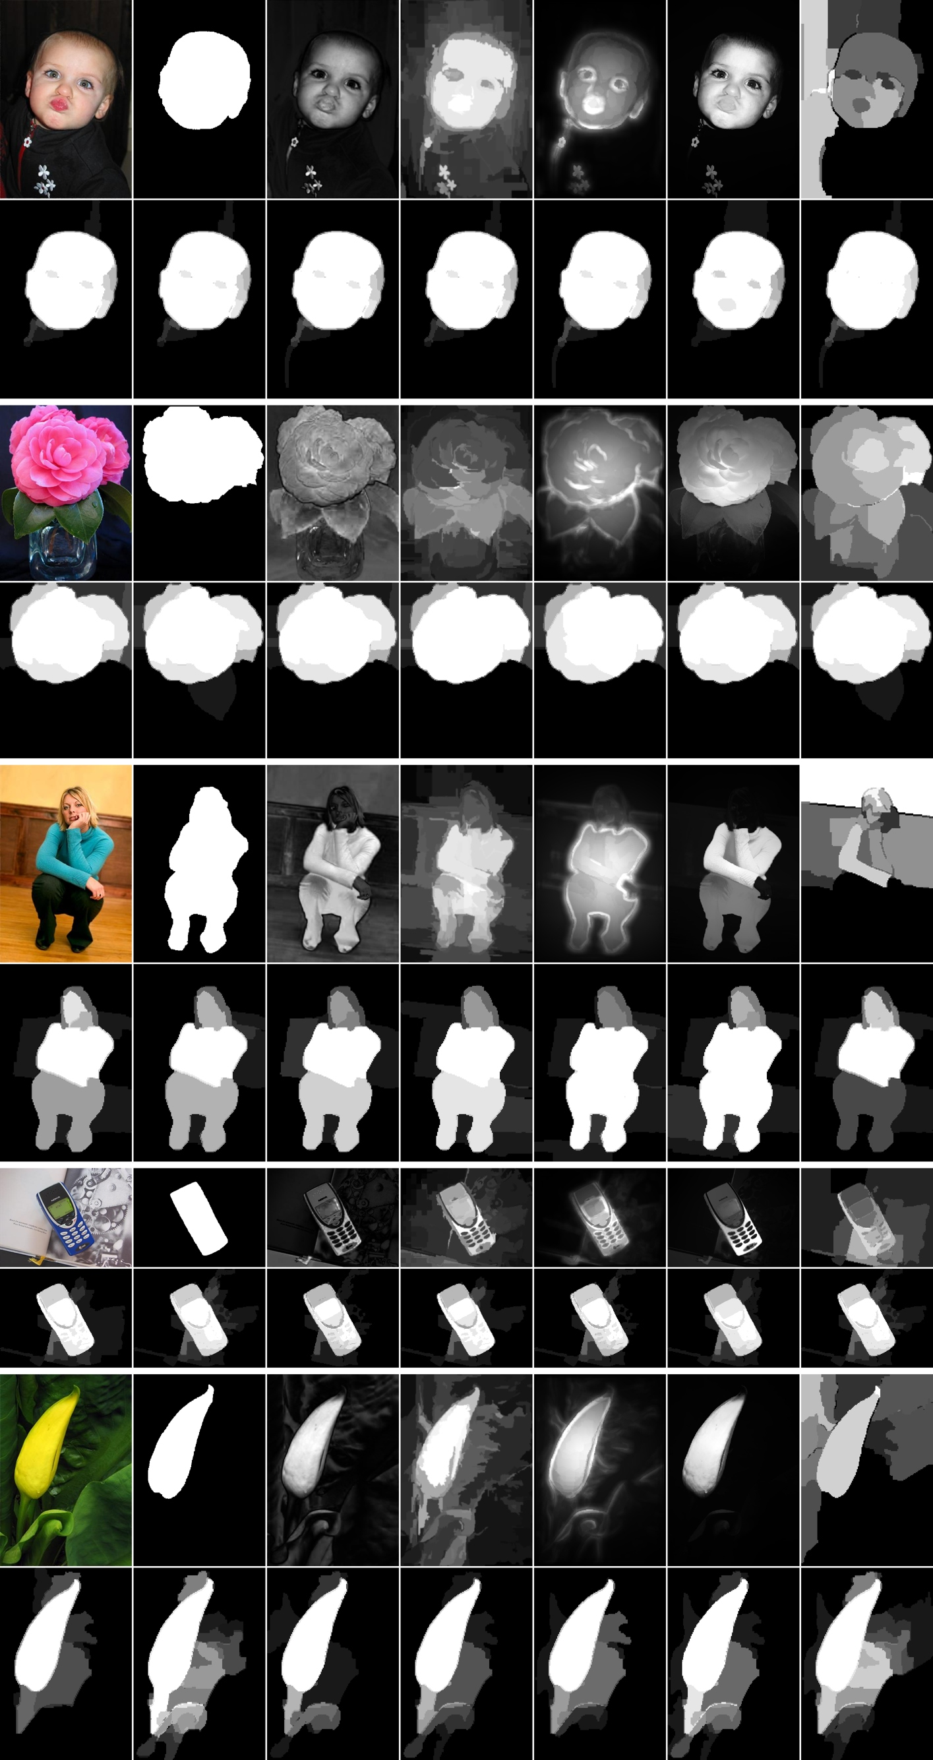
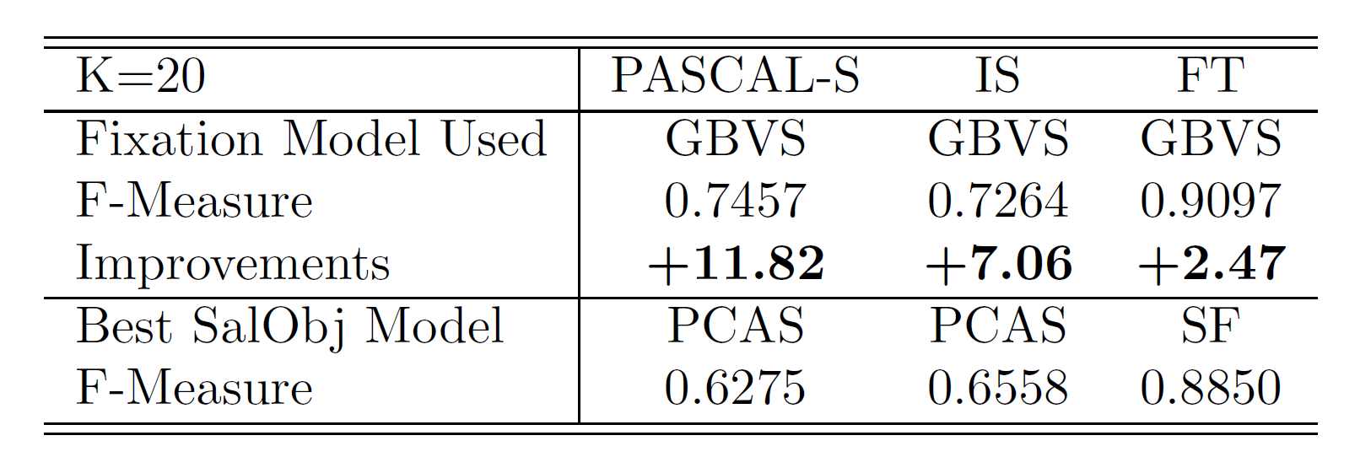
Visualization of salient object segmentation on FT. The first row includes results from existing methods (Left to Right): Original image, Ground-truth mask, FT, GC, PCAS, SF and CPMC ranking; The second row shows results of our method using different fixations (Left to Right): AIM, AWS, DVA, GBVS, ITTI, SIG and SUN.

Slide 17
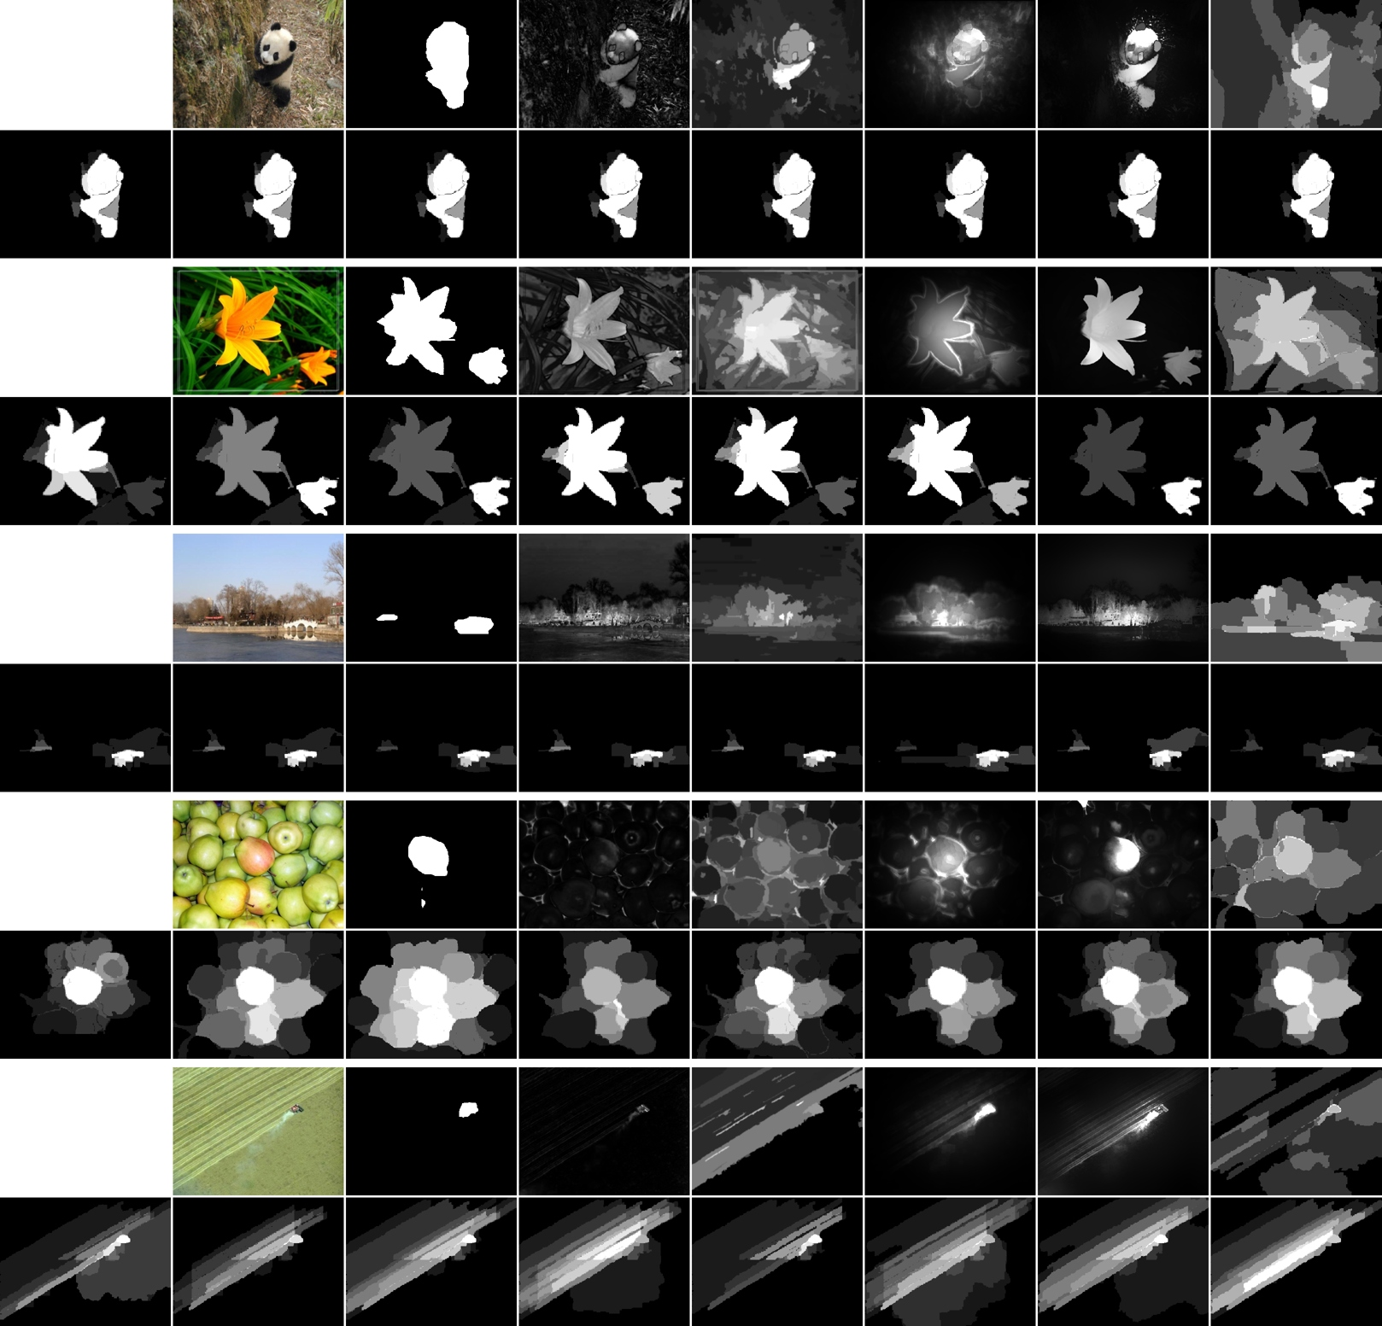
Visualization of salient object segmentation on IS. The first row includes results from existing methods (Left to Right): Original image, Ground-truth mask, FT, GC, PCAS, SF and CPMC ranking. The second row shows results of our method using different fixations (Left to Right): Human Fixation, AIM, AWS, DVA, GBVS, ITTI, SIG and SUN.

Slide 18
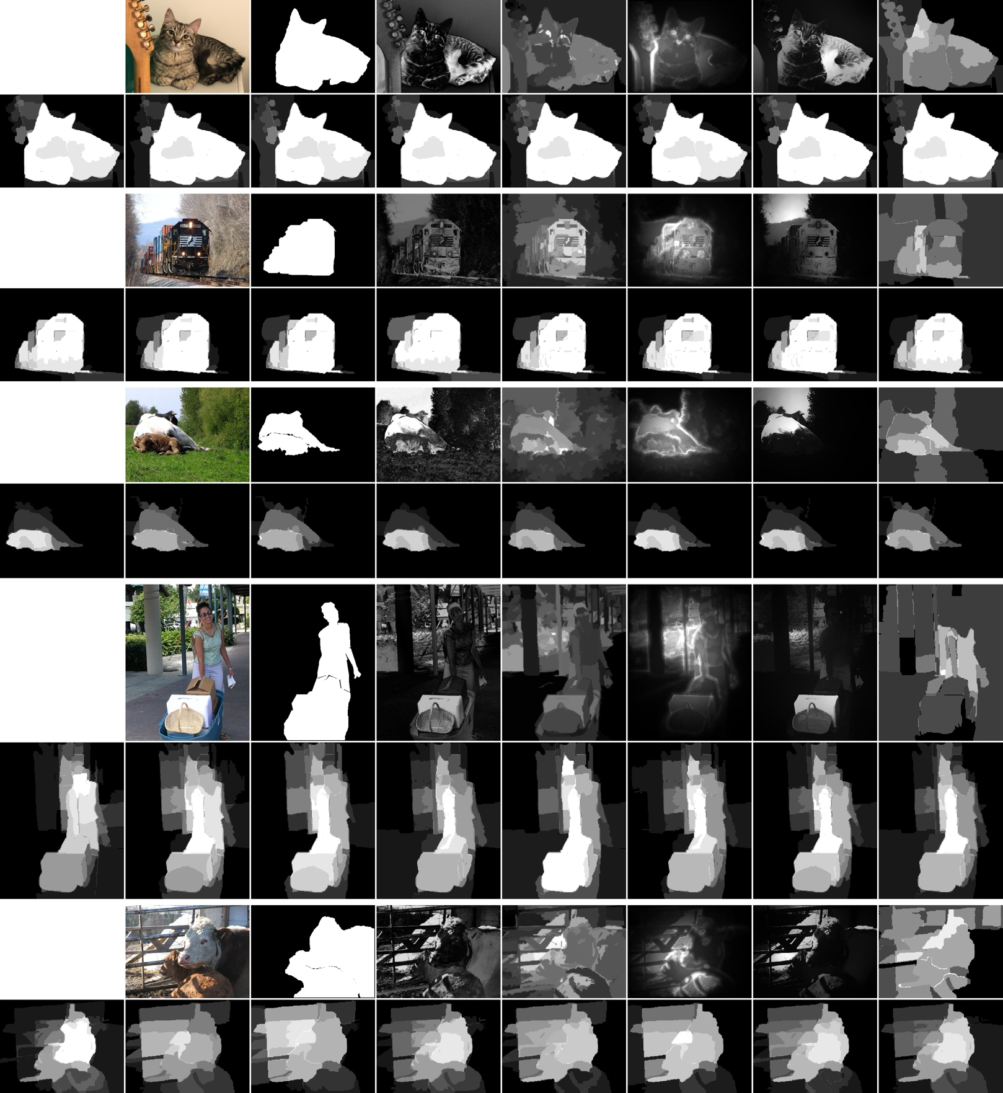
Visualization of salient object segmentation on PASCAL-S.

Slide 19
Conclusion
In this paper, we explored connections between fixation prediction and salient object segmentation by providing a new dataset with both fixations and salient object annotations.
The dataset analysis suggests that the definition of saliency is highly consistent among human subjects.
Pointed out significant dataset design bias in major salient object benchmarks. The bias was largely due to deliberate emphasis on the concept of saliency.
Proposed a new salient object segmentation algorithm which out-performed state-of-the art algorithms.

Slide 20
References
Most of the material is from “The Secrets of Salient Object Segmentation”
http://en.wikipedia.org/wiki/Salience_(neuroscience)#Visual_saliency_modeling
http://www.scholarpedia.org/article/Visual_salience
http://www.klab.caltech.edu/~xhou/
http://cbi.gatech.edu/salobj/
http://groups.inf.ed.ac.uk/calvin/objectness/
Youtube
Wikipedia
Most pictures and graphs are from the website of the paper and the extended version of paper.

Slide 21
Questions

